Slide 1
Orogenic Gold Deposits Through Time:
A Two-Stage Process
Ross Large
CODES ARC Centre of Excellence
University of Tasmania

Slide 2
Two Messages
Orogenic gold deposits form by a two-stage process
The three major gold periods in Earth history (late Archean, Early Proterozoic and Phanerozoic) have a first order control by oxygenation of the atmosphere

Slide 3
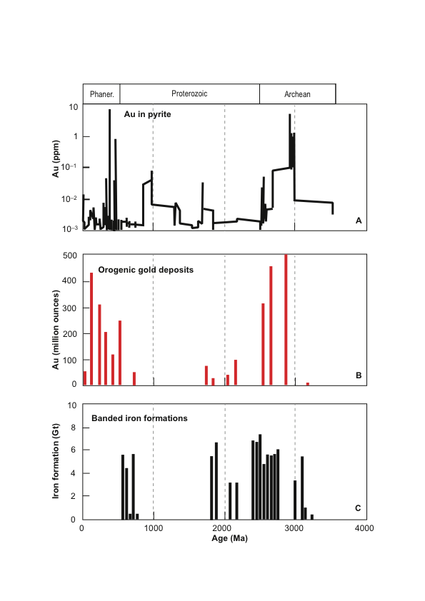
What Controls Gold Ore Distribution
Through Time?
3
2
1
0 1000 2000 3000
After
Goldfarb et al., (2005)
Age (Ma)

Slide 4
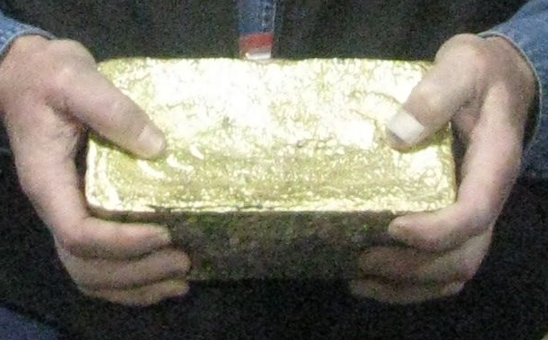
Source of Gold ?
Metal trap
Mantelists
Plutonists
Neptunists
Ore body
Metal transport
Metal source
Geology 101

Slide 5
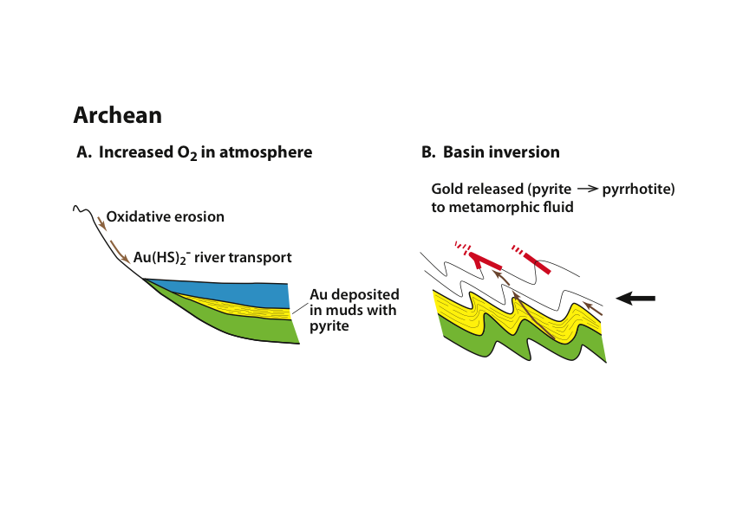
Neptunists Model:
Carbonaceous Shale Source-Rocks
STAGE 1: Gold pre-concentration in shale source rocks
STAGE 2: Gold release from source rocks and second concentration process
Large et al. (2011) – SEG BJ Skinner award

Slide 6
Greenstone Belt Source Rocks for Orogenic Gold
Komatiites and High Mg-basalts
Felsic Volcaniclastics
Carbonaceous Shales

Slide 7
Examples of the two Stage Process
Sukhoi Log, Russia
Kumtor, Central Asia
Bendigo, Victoria
Witwatersrand, South Africa
Carlin ores, Nevada
Kalgoolie, Western Australia

Slide 8
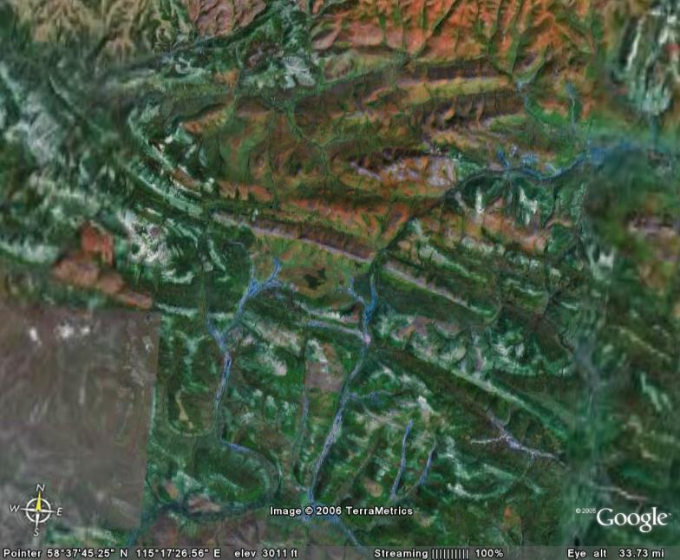
Sukhoi Log - Russia
Gold Deposit
Gold Remobalisation
from 15 km³ @ 30 ppb Au
10 km

Slide 9
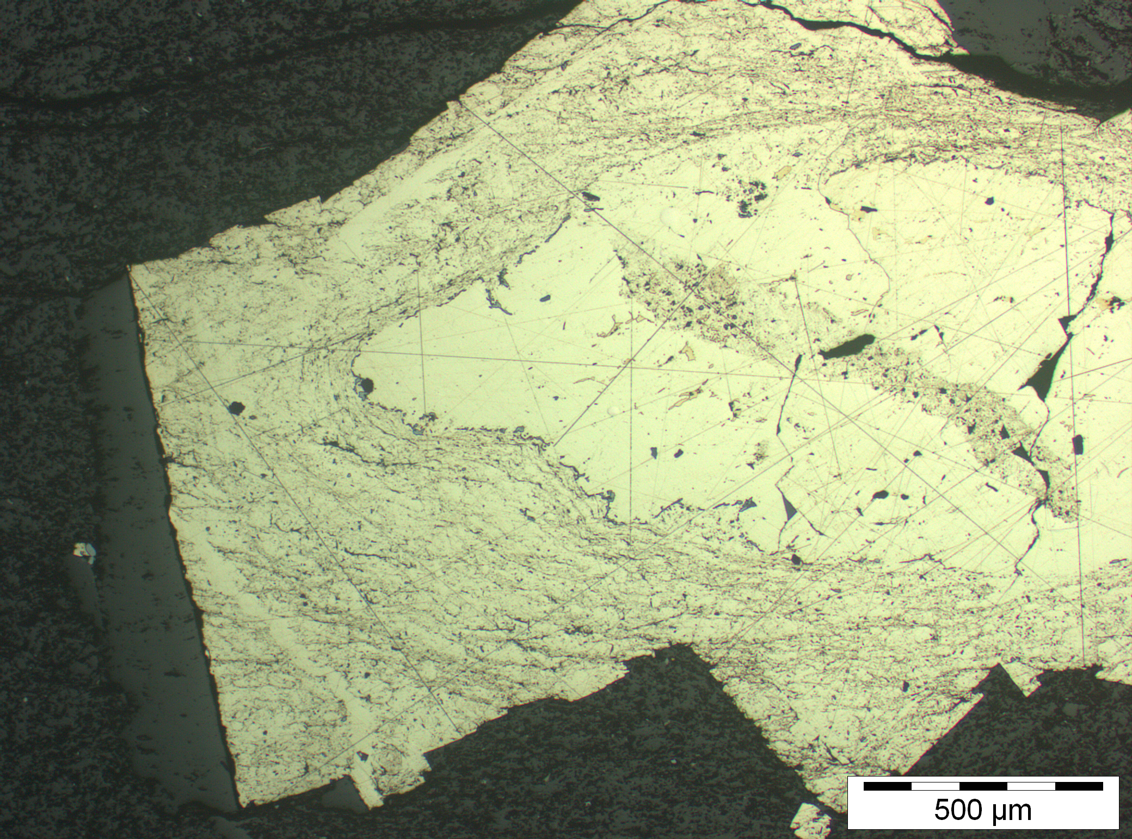
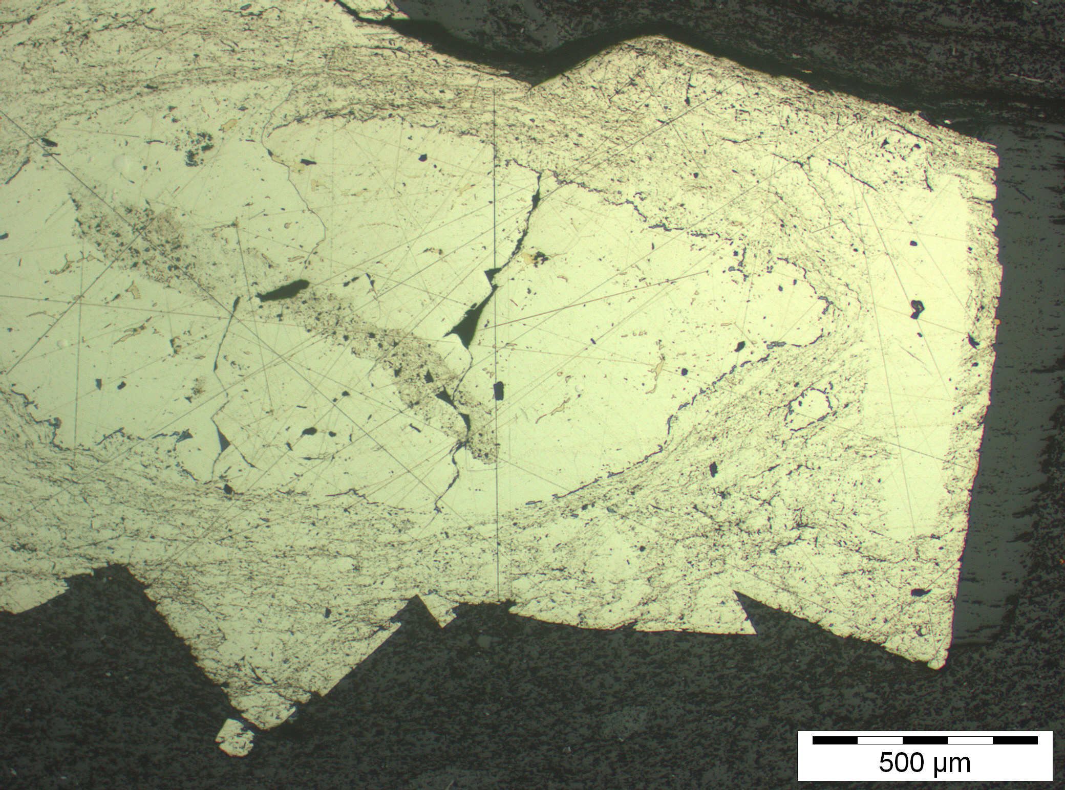
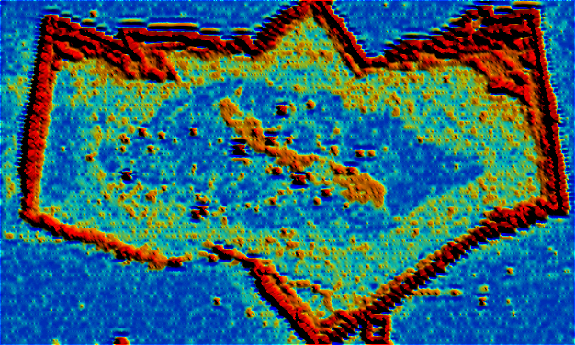
Bendigo Pyrite Reveals
TWO Stage Process
Thomas et al. (2011)
STAGE 2
Gold in late metamorphic rim
STAGE 1
Gold in
diagenetic
core
Au by LA-ICPMS

Slide 10
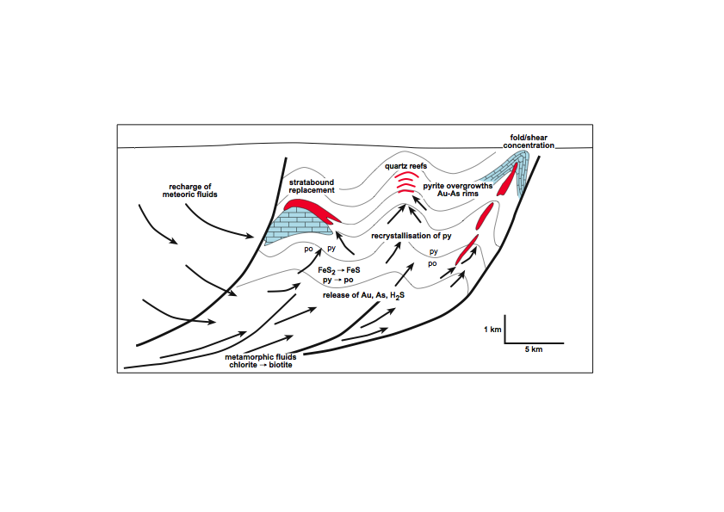
Model for Au-As Release & Concentration in Bendigo Goldfield

Slide 11
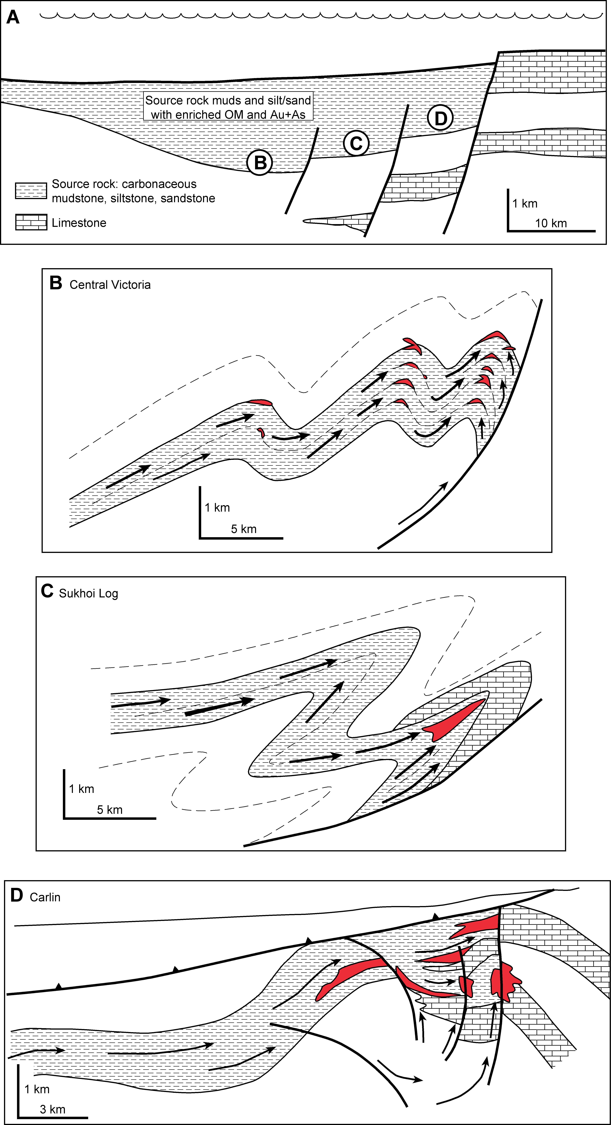
Carlin Model – Great Basin Nevada
Stage 1: Au-As
sedimentary
pre-concentration in Devonian
Stage 2: Au-As
magmatic &
metamorphic
reconcentration in the Tertiary

Slide 12
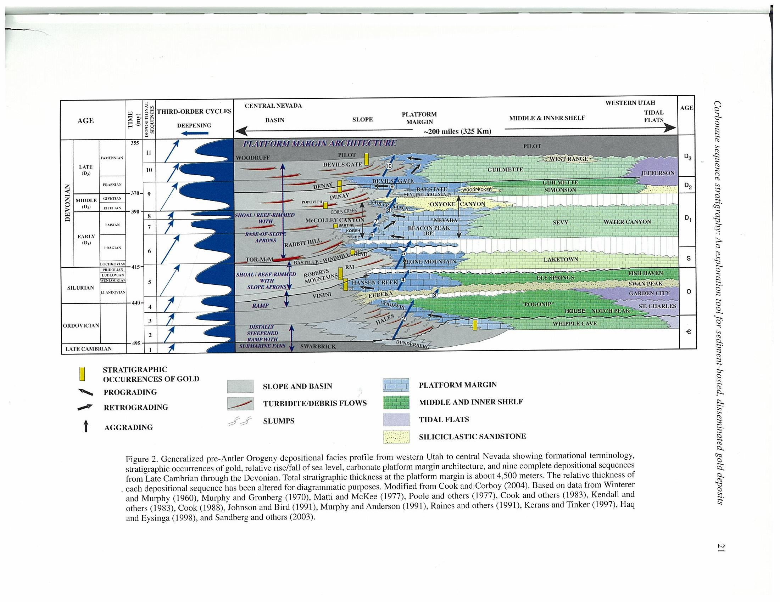
Continental Margin: Slope and Basin Facies
Devonian
Enriched in Au-As
Silurian
Ordovician
Cambrian
(after Cook et al., 2005)

Slide 13
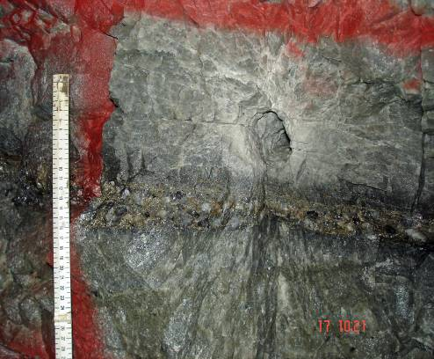
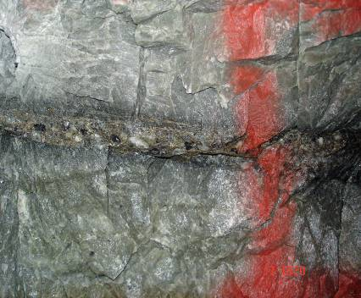
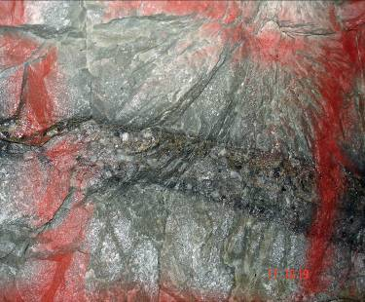
Carbon Leader Reef: Witwatersrand Basin
100 km
JHB
Western Ultra
N
Deep Levels
WITWATERSRAND BASIN
Witwatersrand Basin
South Africa
Gold-bearing conglomerate reef

Slide 14
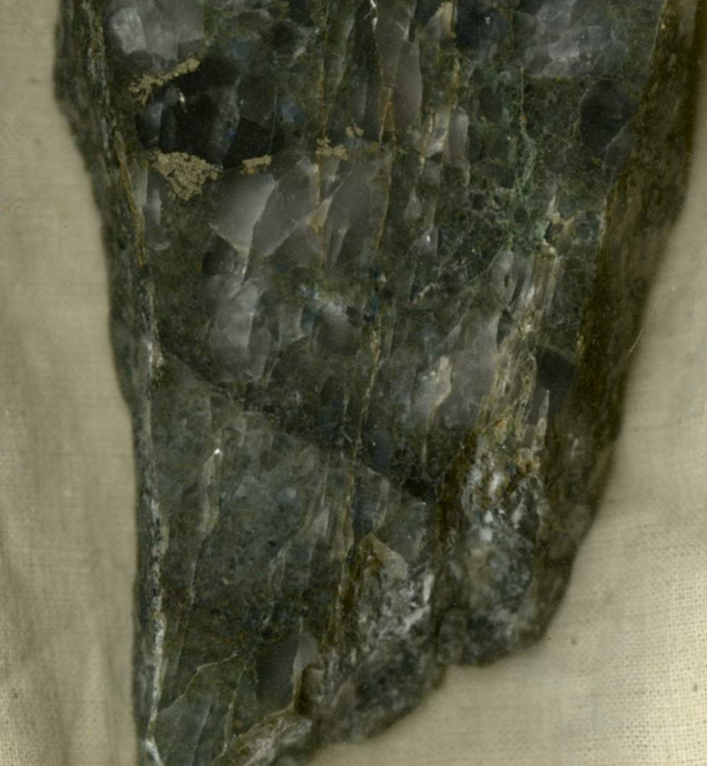
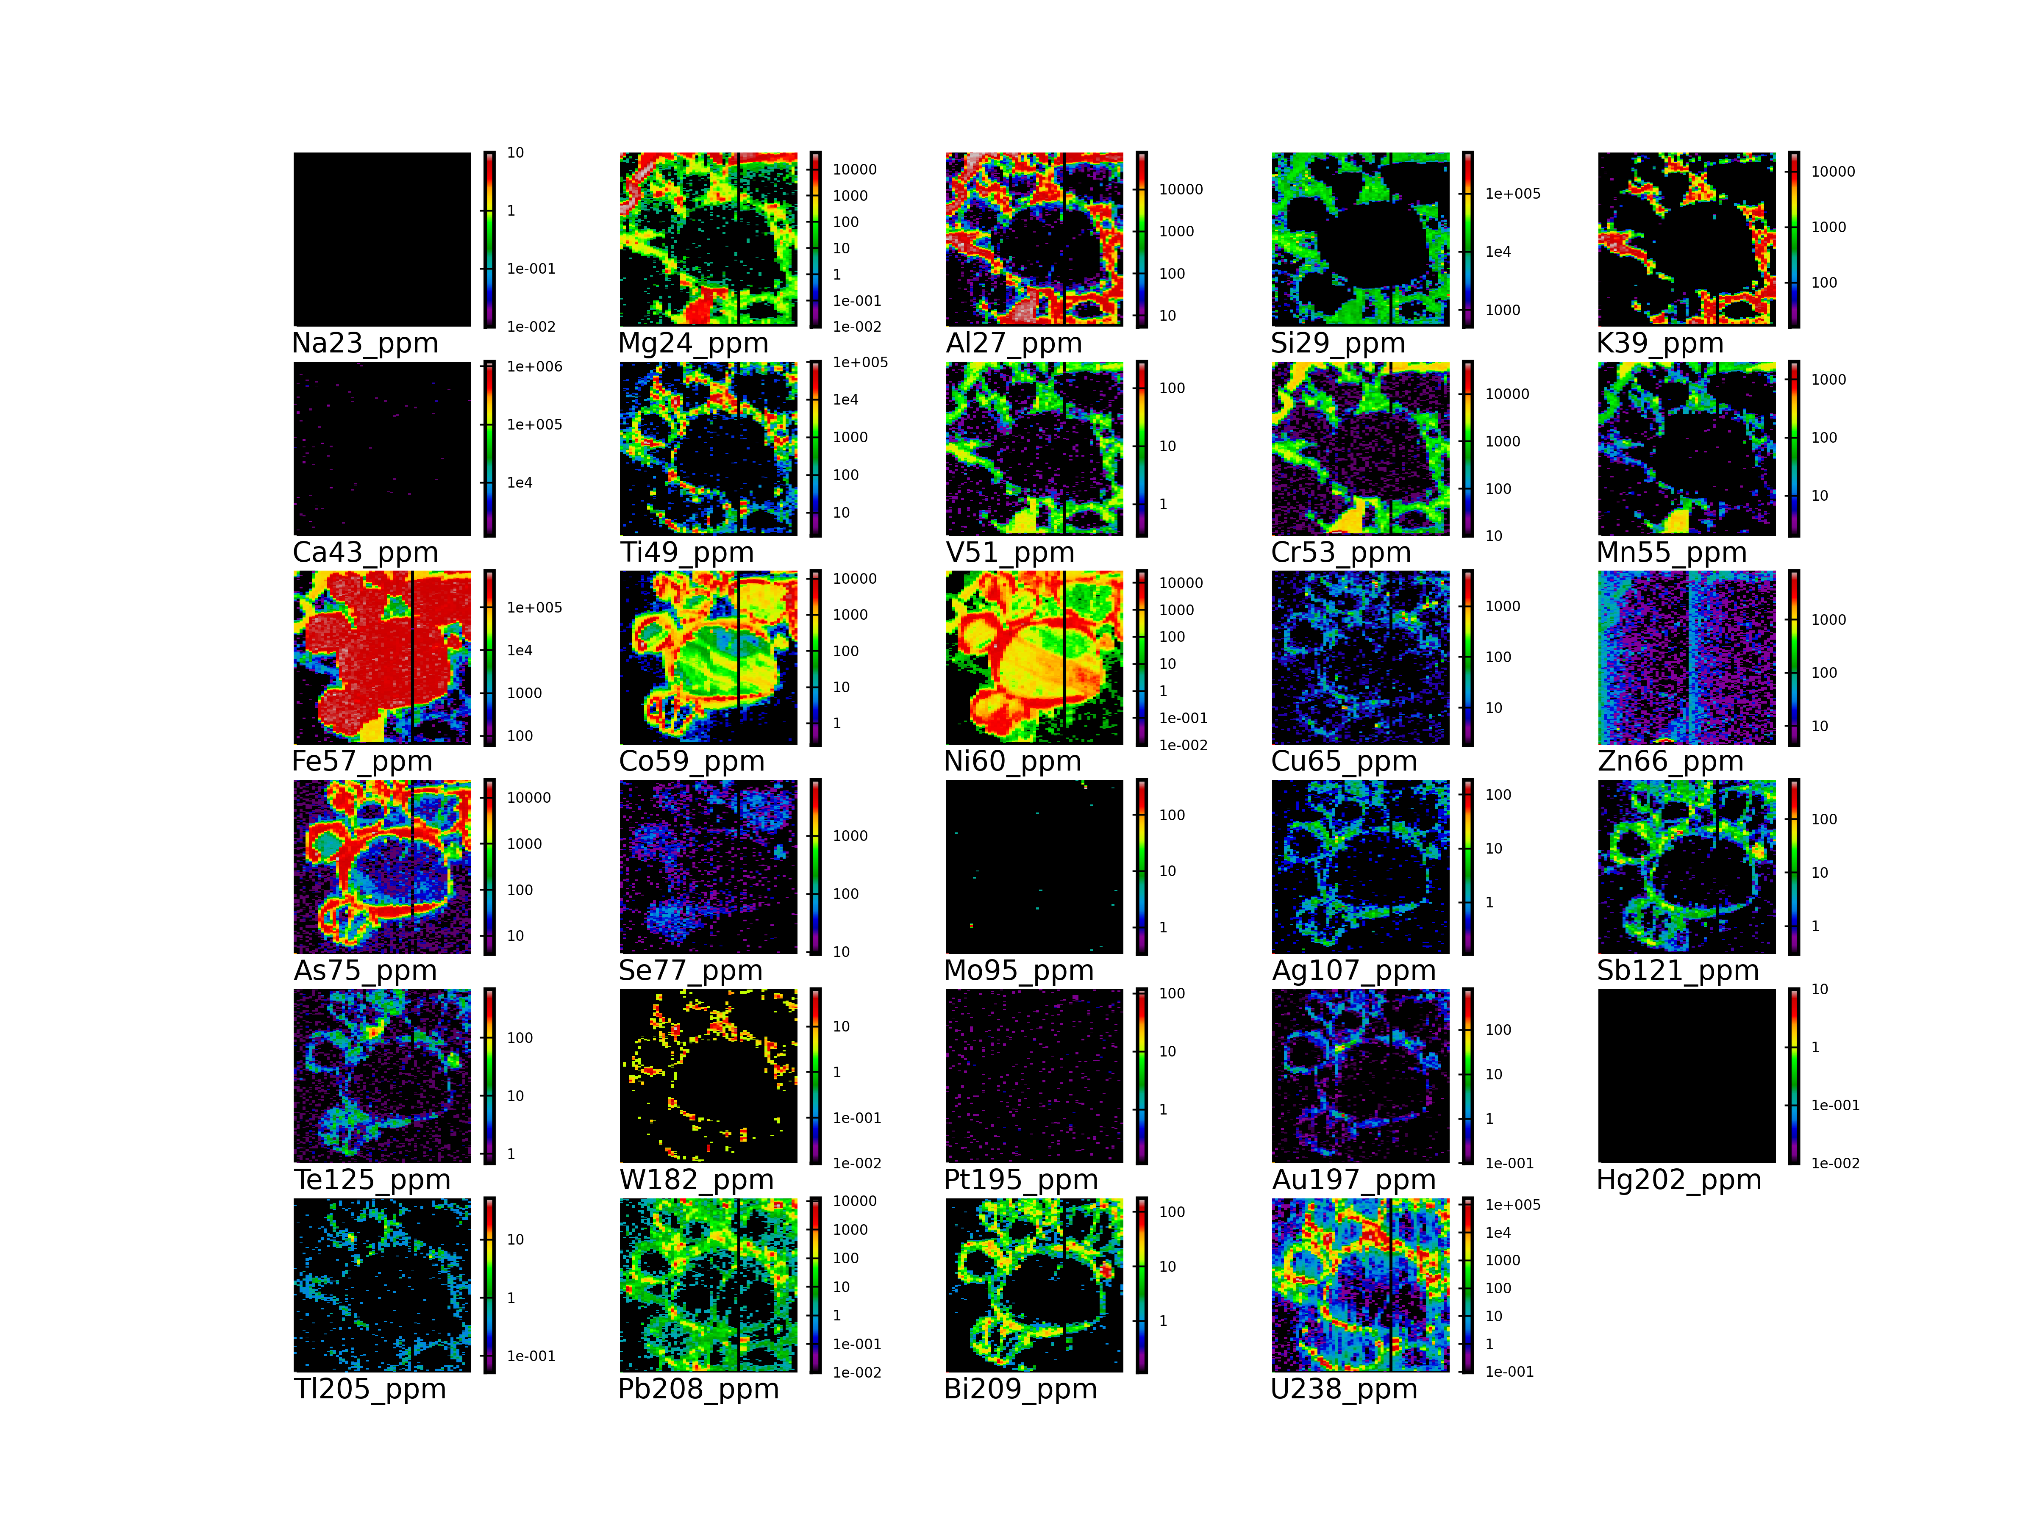
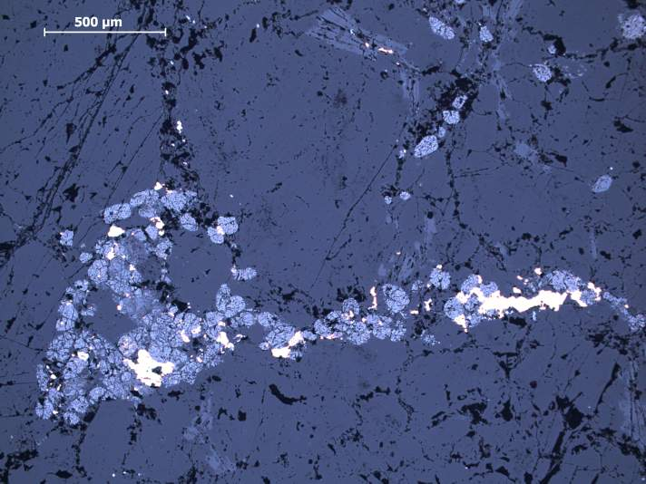
Carbon Leader Reef
Stage 2 at 2100 Ma
Stage 1 at 2900 Ma
E
Au
D
Large et al. (2013) –
latest edition of
Economic Geology

Slide 15
Examples of the Two-Stage Process
Sukhoi Log, Russia
Kumtor, Central Asia
Bendigo, Victoria
Witwatersrand, South Africa
Carlin ores, Nevada
Kalgoolie, Western Australia

Slide 16
Issue 2:
What Controls Gold Ore Distribution Through Time?
3
2
1
0 1000 2000 3000
Age (Ma)

Slide 17
Sedimentary Pyrite Textures
a
b
200μm
1000μm
c
d
200μm
1000μm
e

Slide 18
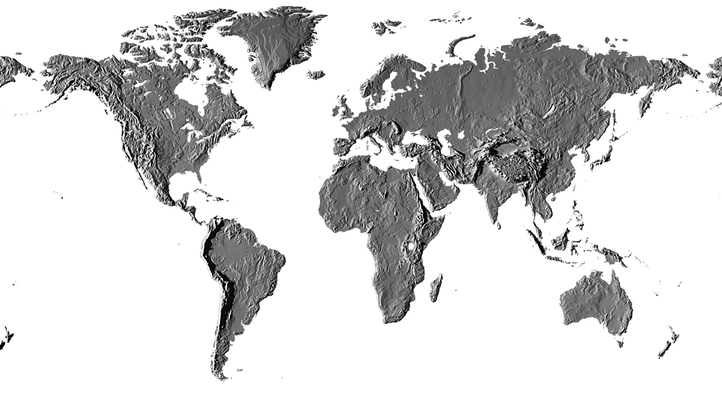
CODES Pyritic Black Shale Data Base
Black Shale localities

Slide 19
Concentration Factors
Ocean TE to Pyrite TE
 |  | Co | Ni | Cu | Zn | As | Au | Te
Mean Cariaco pyrite | ppm | 81 | 500 | 537 | 666 | 339 | 0.20 | 5.38
Mean modern ocean | ppt | 1.2 | 480 | 150 | 350 | 1200 | 0.02 | 0.07
Concentration factors | x10⁷ | 7 | 0.1 | 0.4 | 0.2 | 0.03 | 1 | 8

Slide 20
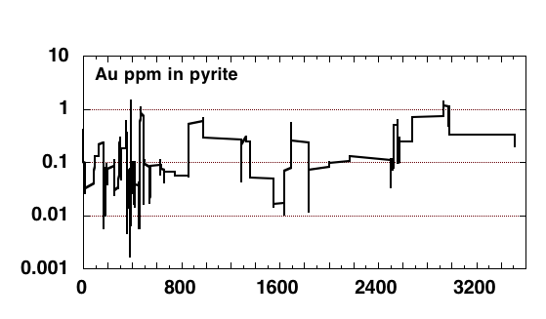
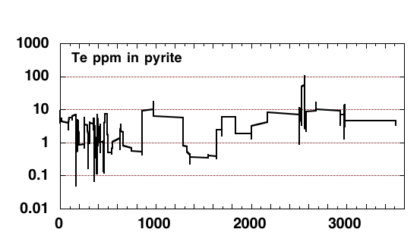
Au and Te in Sedimentary Pyrite
Proterozoic
Archean
Gold in
seawater
1
0.1
0.01
0.001
0.0001
Au
ppm
ppt
Te
ppm

Slide 21
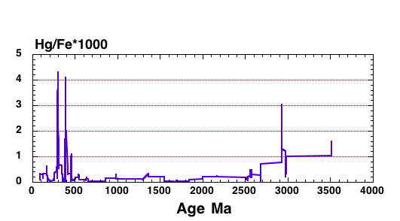
Au and Hg in Sedimentary Pyrite
Proterozoic
Archean
Gold in
seawater
1
0.1
0.01
0.001
0.0001
Au
ppm
ppt
Hg GLOBAL TIME CURVE: sedimentary pyrite
Great Basin: Carlin Au
Witwatersrand
Basin
Hg/Fe *1000

Slide 22
New CODES Research Project
ADVERTISEMENT
Pyrite Chemistry as Fertility and Vector Tool
Development of a State by State Data Base
WA has joined; invitation out to other States
Companies – please talk to me at this meeting
We hope to leverage ARC Linkage funding on $/$

Slide 23
Back to Pyrite Chemistry
Through Time

Slide 24
22 Trace Element Time Curves
Phan.
Proterozoic
Archaean
Three Trends
Increasing through Precambrian: Mo, Zn, Cd
Decreasing through Precambrian: Ni, Co, Cu, As, Te, Tl, Hg, Sb, Pb, Bi, Cr, Sn, W
Increasing, then decreasing through Precambrian: Se, U, V
a
Mo
ppm
ppm
b
Ni
c
Co
ppm
d
Se
ppm

Slide 25
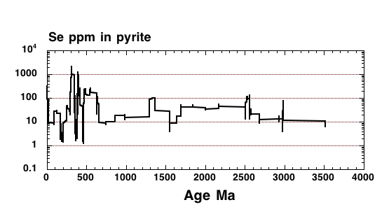
Selenium as an Oxygen Proxy
GOE2
Phanerozoic
GOE1
Proterozoic
Archean
?
?
?
Cryogenian trough

Slide 26
BIFs and Ocean Oxygenation
Oxygenation
Proxy
(Bekker et al., 2010)

Slide 27
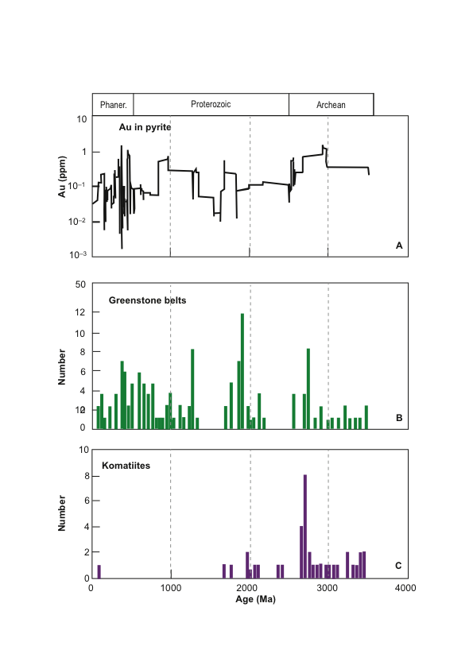
Gold in Oceans
Greenstone Belts
(Condie, 1994)
Komatiites
(Isley and Abbott, 1999)

Slide 28
Two Stage Process
of komatiites

Slide 29
Gold in the Ocean versus Gold in orogenic
and sediment-hosted deposits
Golden Age Intervals
3000-2500 Ma
2250-1800 Ma
600-0 Ma
Boring billion
After
Goldfarb et al.,
(2005)

Slide 30
Oxygenation of Atmosphere versus Gold in
Orogenic and sediment-hosted deposits
Se
ppm
?
After
Goldfarb et al.,
(2005)
Au
mill.
Ozes

Slide 31
Boring billion caused by sustained decrease in atm. O₂
Coincidence of Precambrian Gold Deposits
& Banded Iron Formations – both related to O₂ in atm.
Gold deposits
Boring billion
Banded iron formations
Se in pyrite
Se
ppm

Slide 32
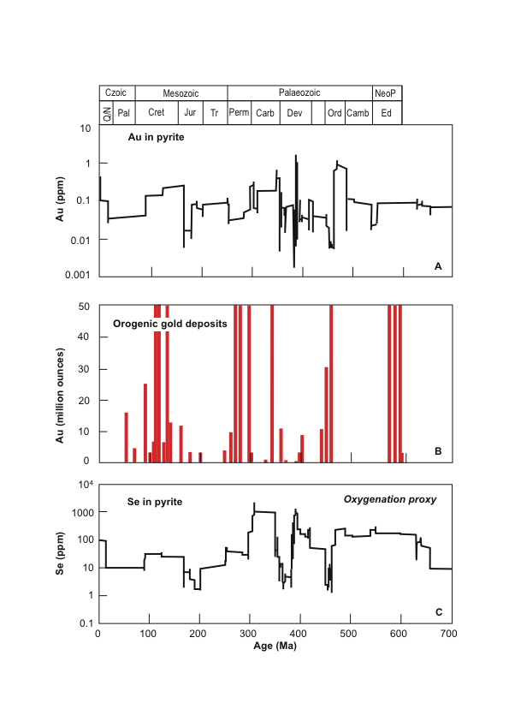
The Phanerozoic Picture
Golden Age Intervals
Ediacran
Late Ordovician
Dev-Carb (Carlin)
Permian
Cretaceous
Au
million
ounces
Se in
pyrite
proxy
for O₂
in atm.

Slide 33
Neptunist Conclusions
Case studies on major gold deposits demonstrate that high quality orogenic deposits form by a two-stage or sometimes multi-stage process
The Archean ocean was enriched in Au, Te and As
Cycles of gold through time, parallel cycles of BIF and black shales, and are related to cycles of atmosphere oxygenation

Slide 34
Thank You
Acknowledgements
Jacqueline Halpin
Leonid Danyushevsky
Valeiy Masslennikov
Stuart Bull
Dan Gregory
Jeff Steadman
Elena Lounejeva

